Slide 1

Dynamic Seat Booking System
Subtitle: A modern approach to capacity & schedule management
Presenter: Vaibhav Chaudhary

Slide 2
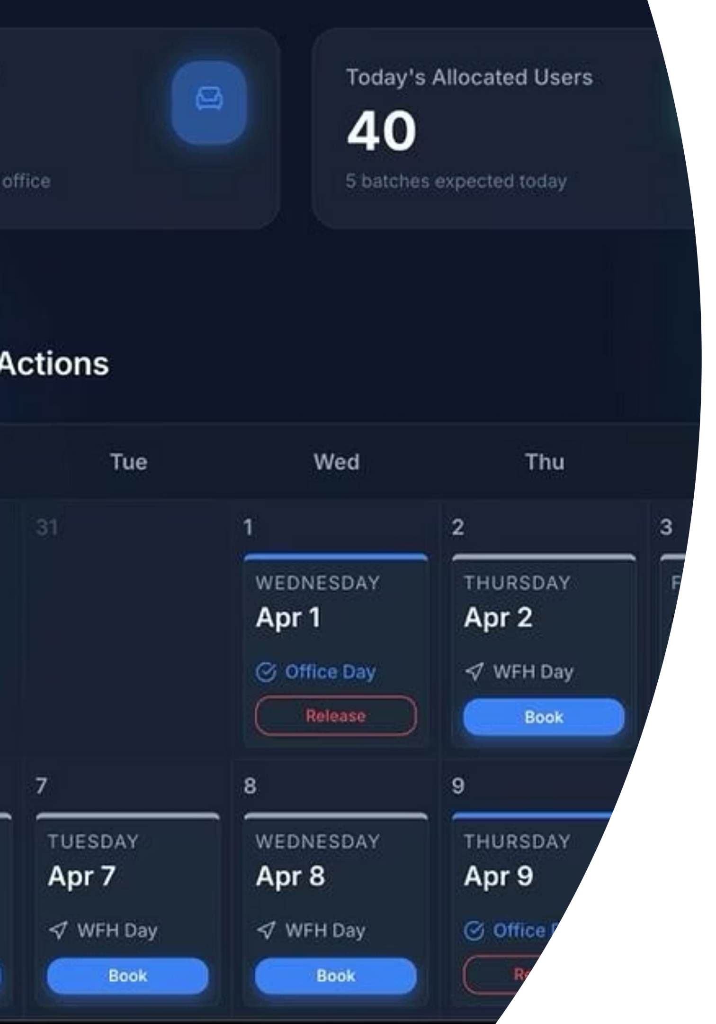
Core Architecture & Allocation Logic
Challenge
Algorithm
50 physical seats, 80 users across 10 overlapping batches on continuous 14‑day rotations — must deterministically map office vs WFH days forever.
14‑day modulo cycle assigns each user to Office or WFH by day index. Deterministic, easy to reason about for future dates and audits.
State Management
Floaters Strategy
SeatContext (React) centralises bookings, releases, holiday locks and floater calculations. Single source of truth for UI and simulator.
10 base floaters computed daily; pool adjusts automatically for active vacations/leaves and released allocations.

Slide 3
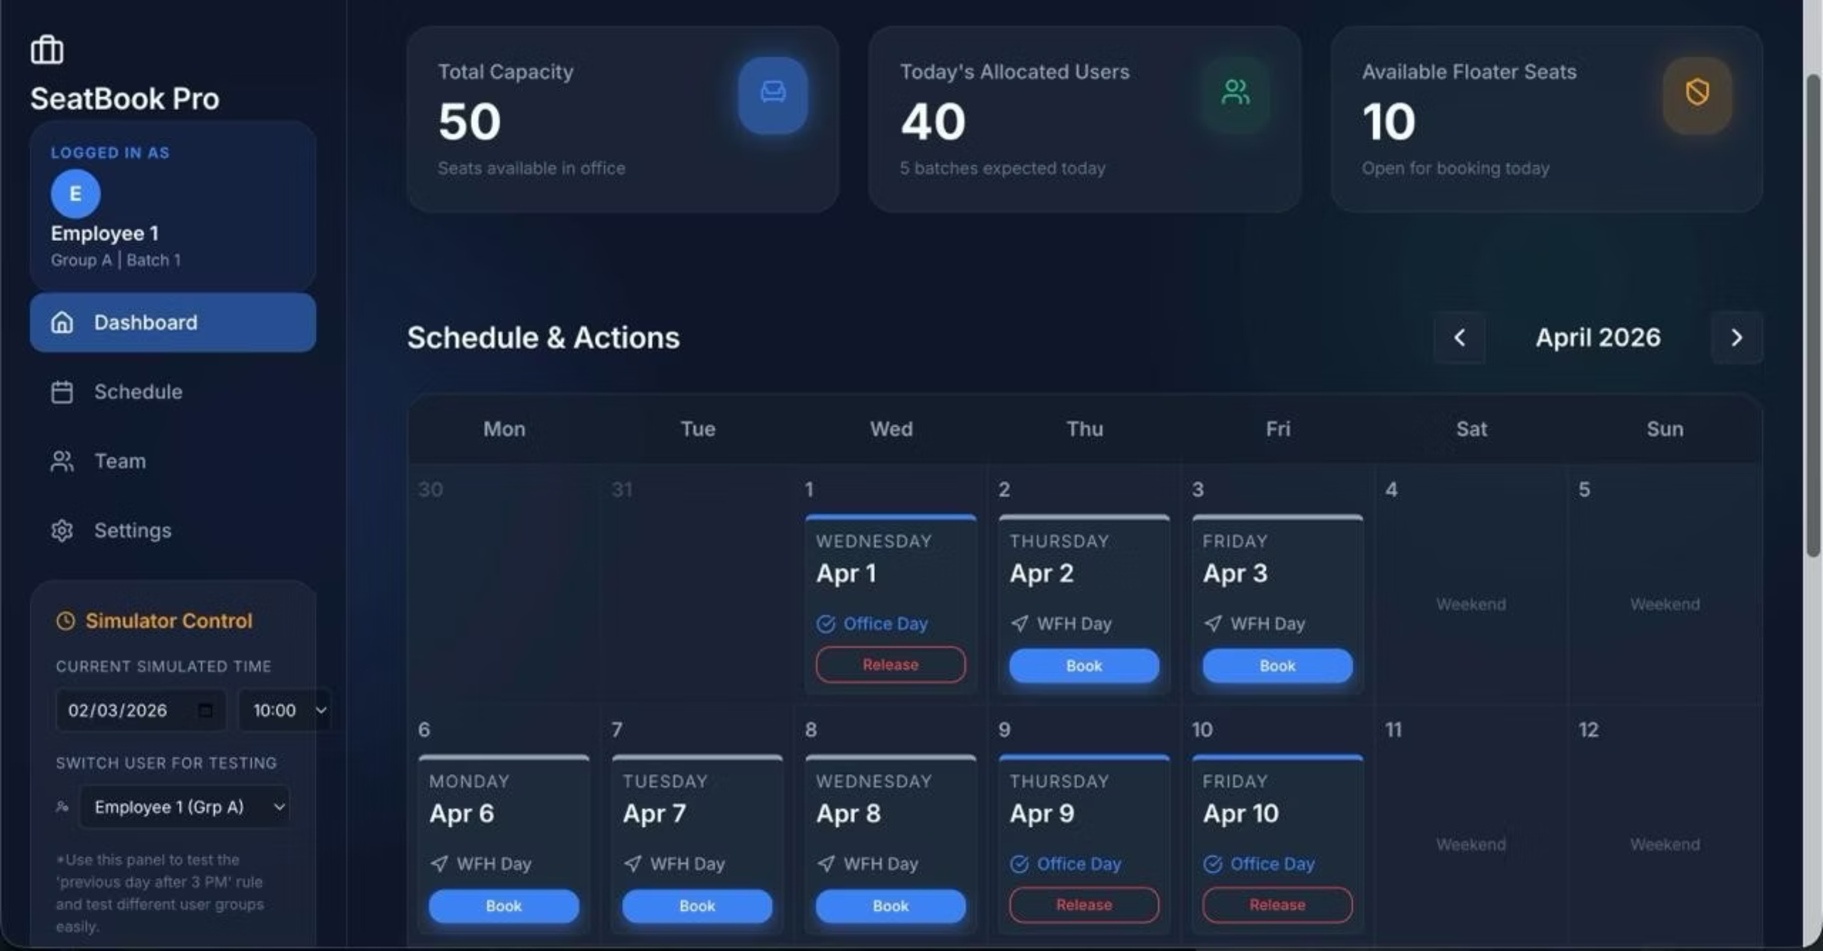

Slide 4
Tech Stack
Frontend: React 18 (Modular Component Architecture)
Build Tool: Vite (High-performance bundling & dev server)
Styling: Custom CSS (Variables, Grid, Flexbox, Responsive Design)
State Management: React Context API (Lightweight global state)
Utilities: date-fns (Date logic & scheduling engine)
UI Enhancements: lucide-react (Modern icon system)
Key Takeaway
Built-in simulation + deterministic logic creates a predictable and testable system
Enables faster validation across product, engineering, and UX — no real-time dependency

Slide 5
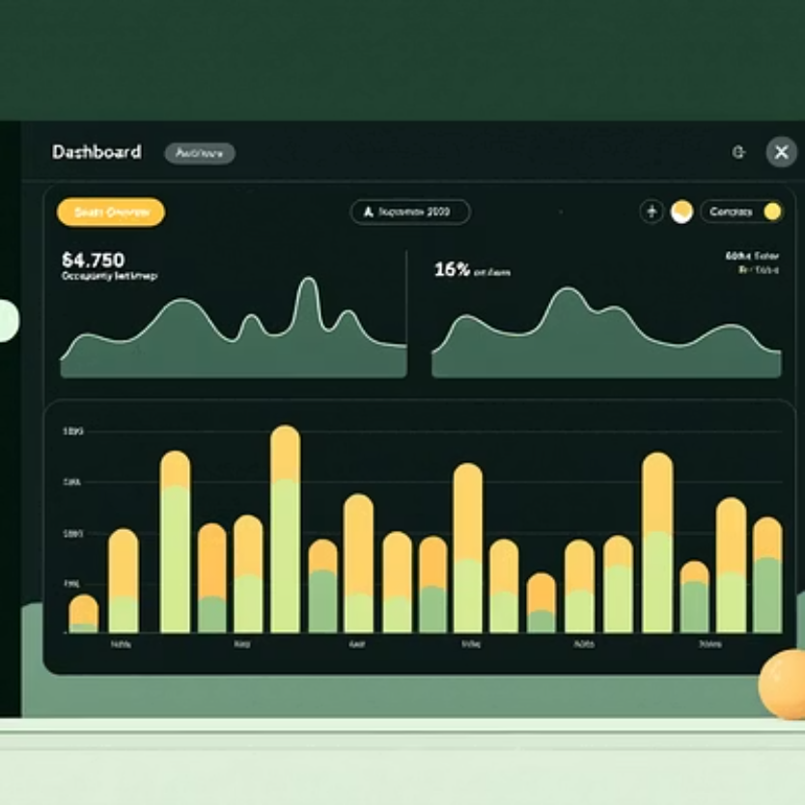


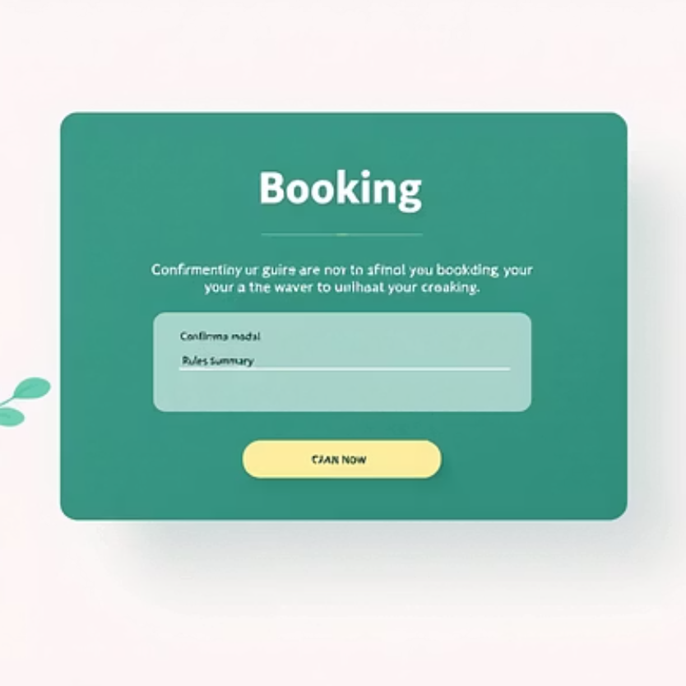
Simulation Screenshots & Review Assets
Next Steps
Validate edge-case permutations with simulator (vacation spikes, mass releases).
Accessibility audit for contrast and keyboard flows.
Load-test SeatContext under concurrent bookings and simulated timezone shifts.
Questions for Review
Do rules and cutoffs match HR policies across regions?
Are holiday sources (manual vs API) correctly prioritised?
Any UX preferences for floater visibility or notification cadence?

